Slide 1
Web development
Student: Nicole Jade D. Fernandez 潔妮可
Teacher: My dear great teacher

Slide 2
agenda
Web programming
Web server and database
HTML programming
CSS
Server side programming (PHP)
JAVAscript
My funny web site

Slide 3
Web Programming https://en.wikipedia.org/wiki/Web_development
Web development is the work involved in developing a website for the Internet or an intranet. Web development can range from developing a simple single static page of plain text to complex web applications, electronic businesses, and social network services.

Slide 4

Web Server Database
A database server is any server that runs a network database application and maintains database files, such as Microsoft SQL Server or Oracle. SQL Server is a high-performance database management system.
Example: XAMPP

Slide 5

XAMPP
Xampp is a stack server which contains Apache HTTP Server, Maria DB database, and interpreters for scripts written in the PHP and Perl programming languages.

Slide 6
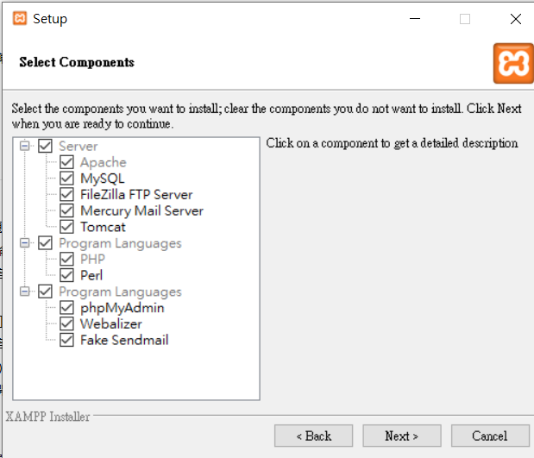
PROGRAM LANGUAGES is a language in technology which use different kind of codes for outputs in programming or Technology.

Slide 7
https://en.wikipedia.org/wiki/Webalizer

Slide 8
phpMyAdmin is a free software tool written in PHP
A web interface for MySQL and MariaDB.
https://docs.phpmyadmin.net/,

Slide 9
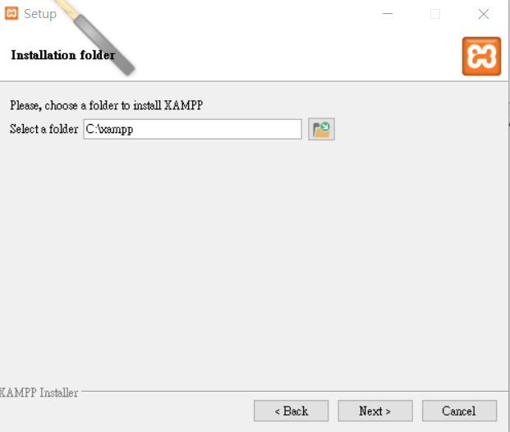

Slide 10
XAMPP HTML PROGRAMMING (my works)

Slide 11
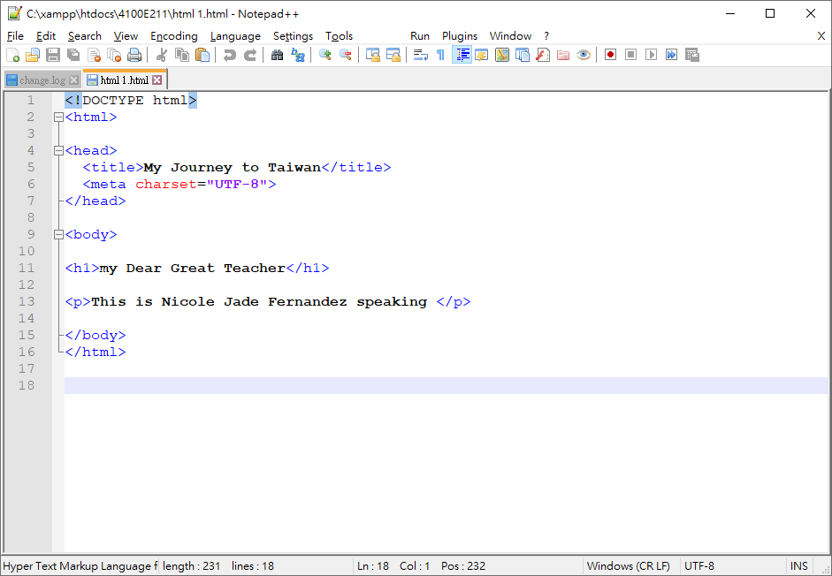
XAMPP HTML PROGRAMMING
HTML 1.html
Headings
Note++ codes

Slide 12
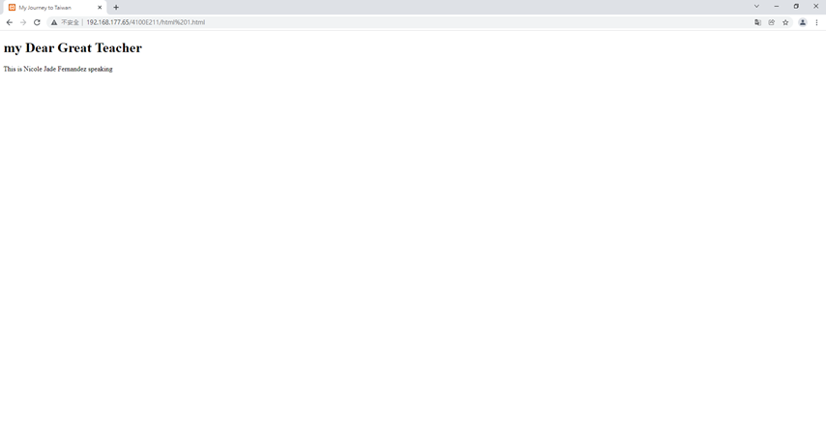
Result

Slide 13
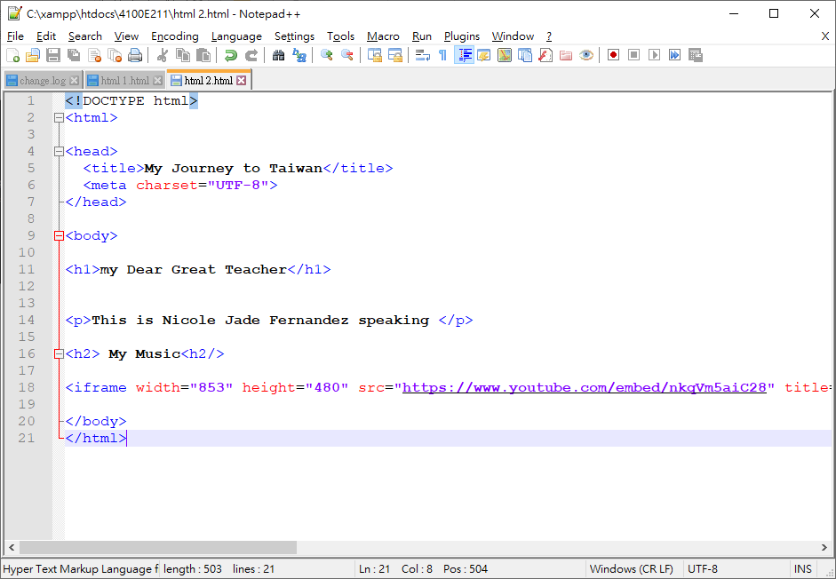
XAMPP HTML PROGRAMMING
Html 2.html
Note++ codes

Slide 14
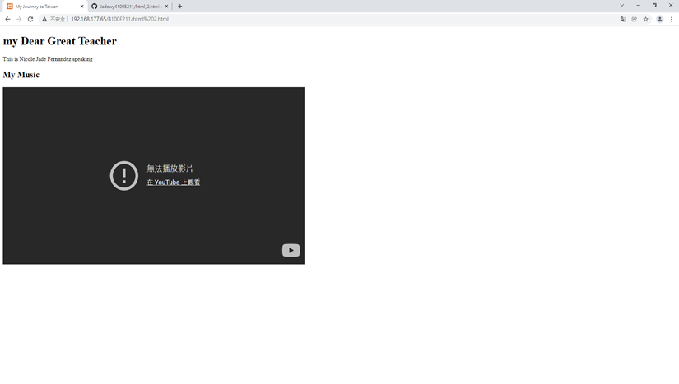
Result

Slide 15
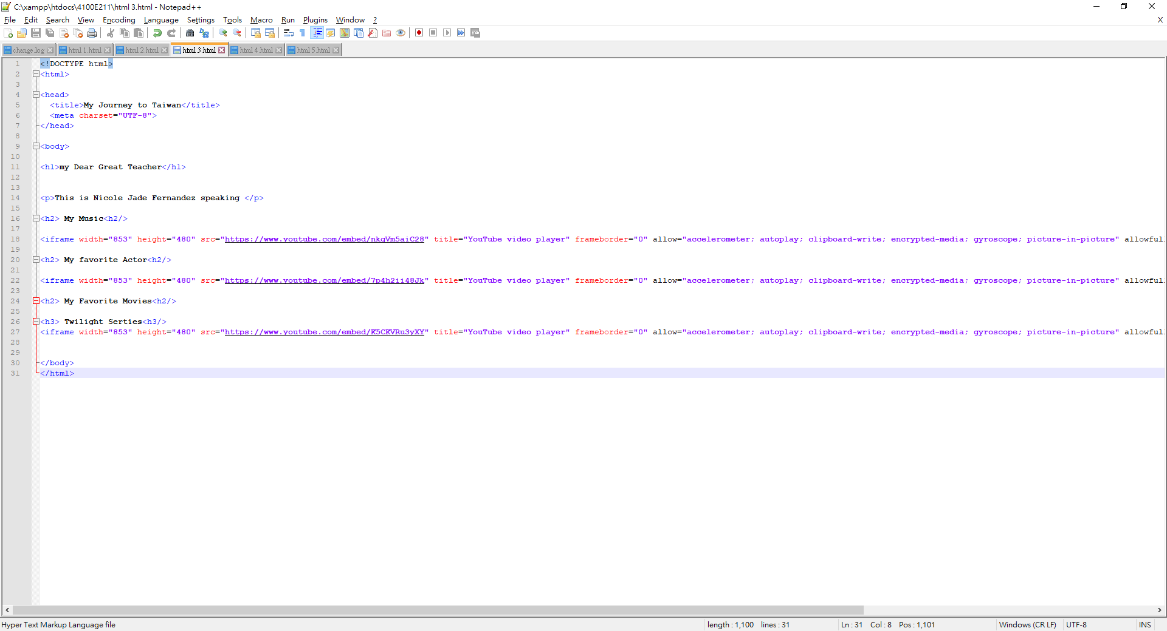
XAMPP HTML PROGRAMMING
Html 3.html

Slide 16
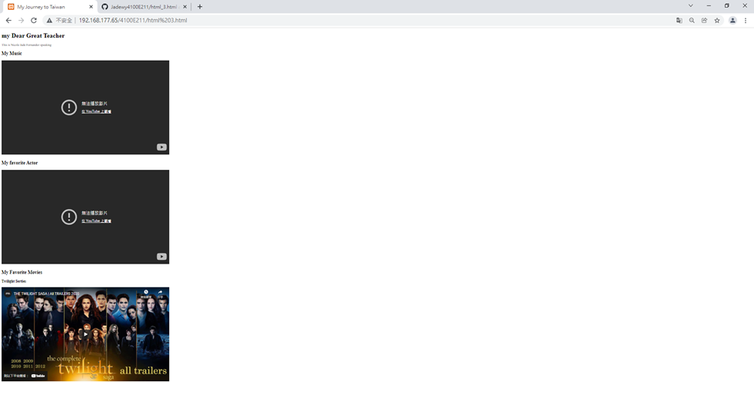
Result

Slide 17
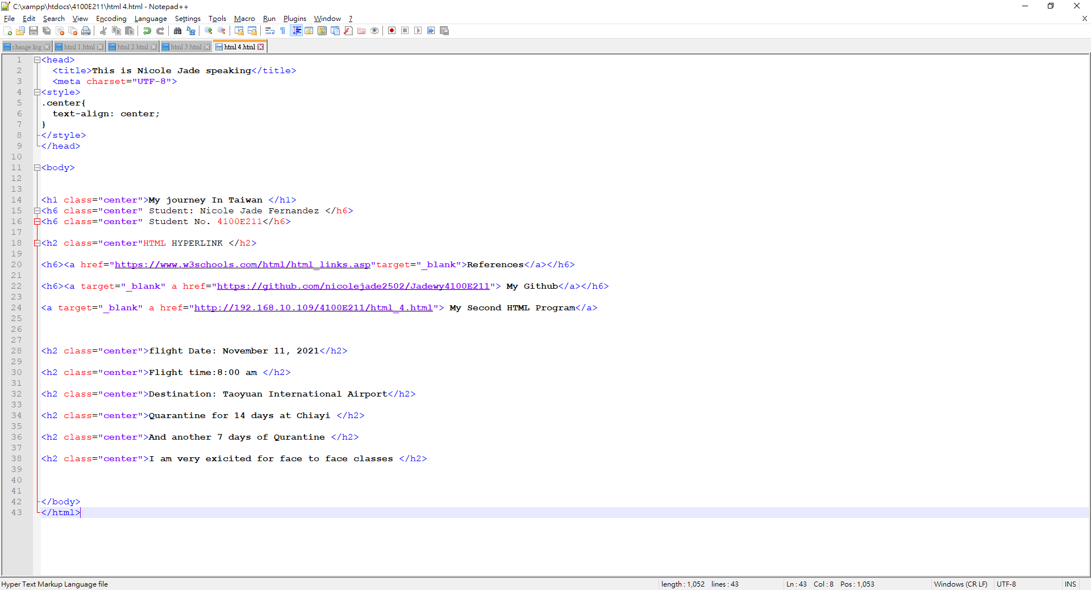
XAMPP HTML PROGRAMMING
Html 4.html

Slide 18
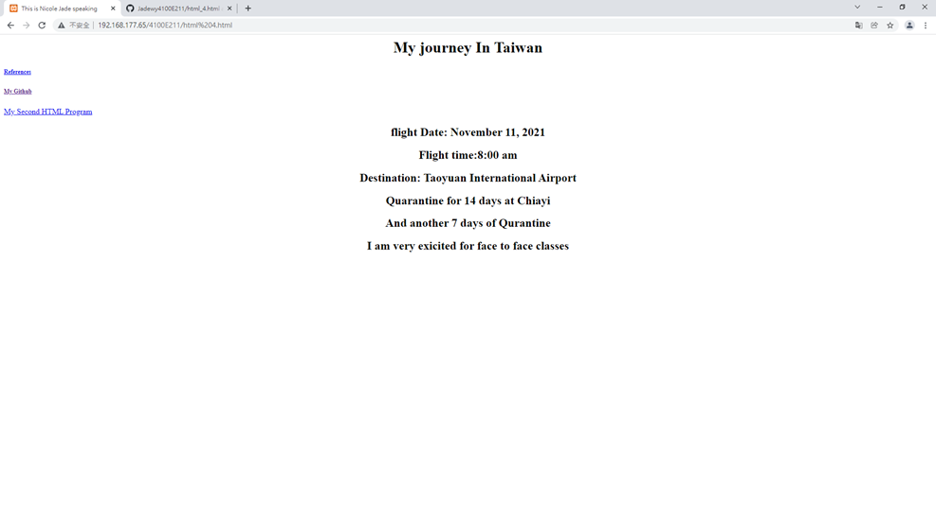
Result

Slide 19
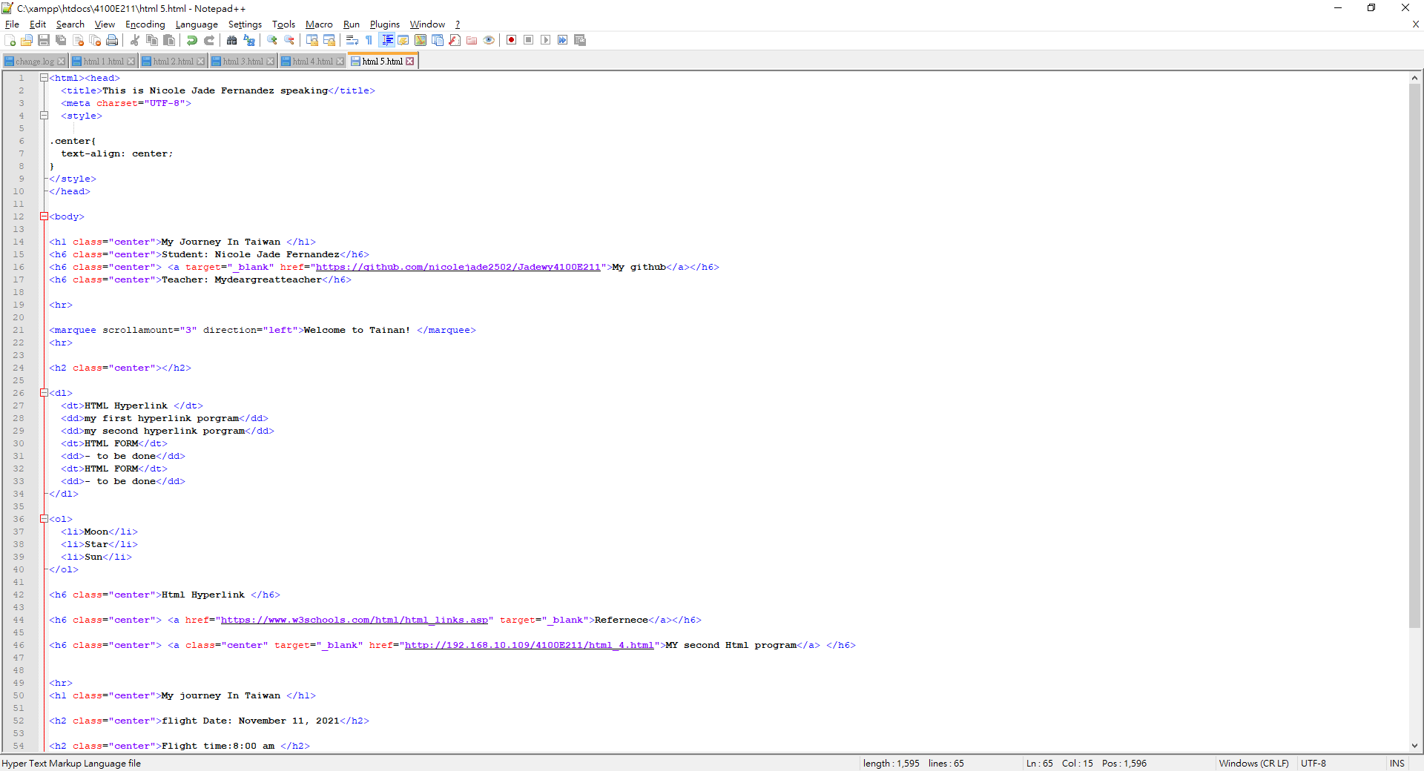
XAMPP HTML PROGRAMMING
HTML 5.html

Slide 20
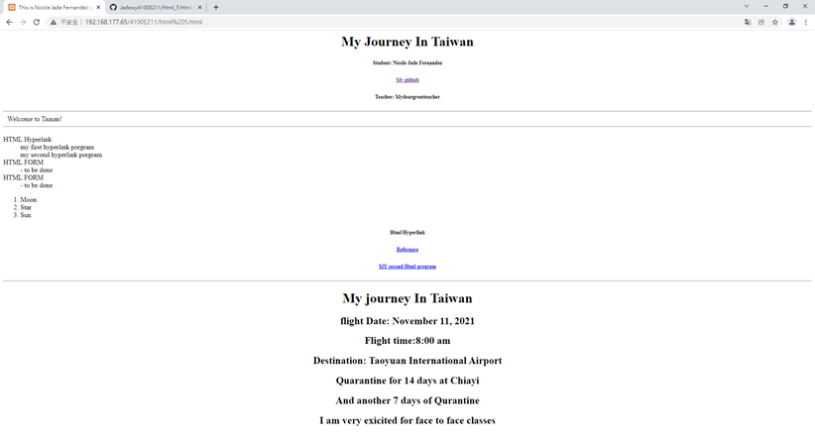
Result

Slide 21
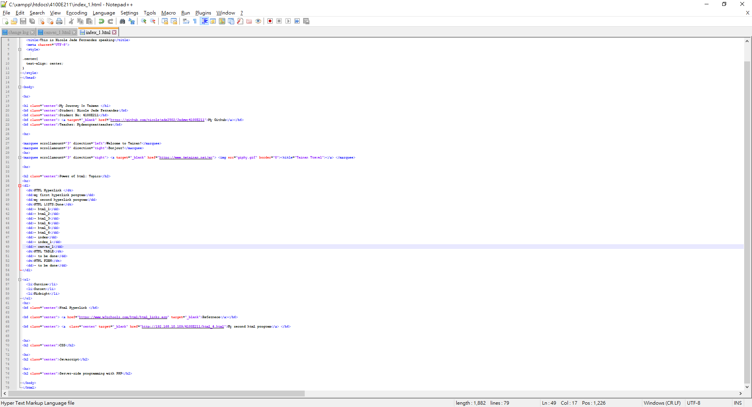
XAMPP HTML PROGRAMMING
Index_1.html

Slide 22
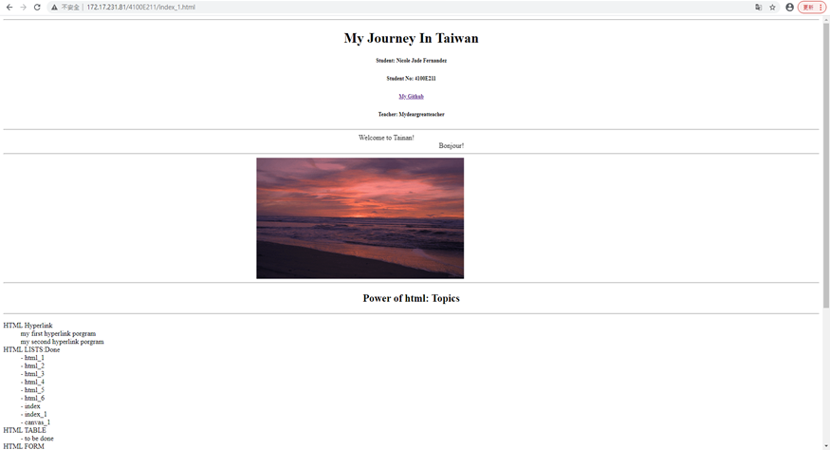
Result

Slide 23
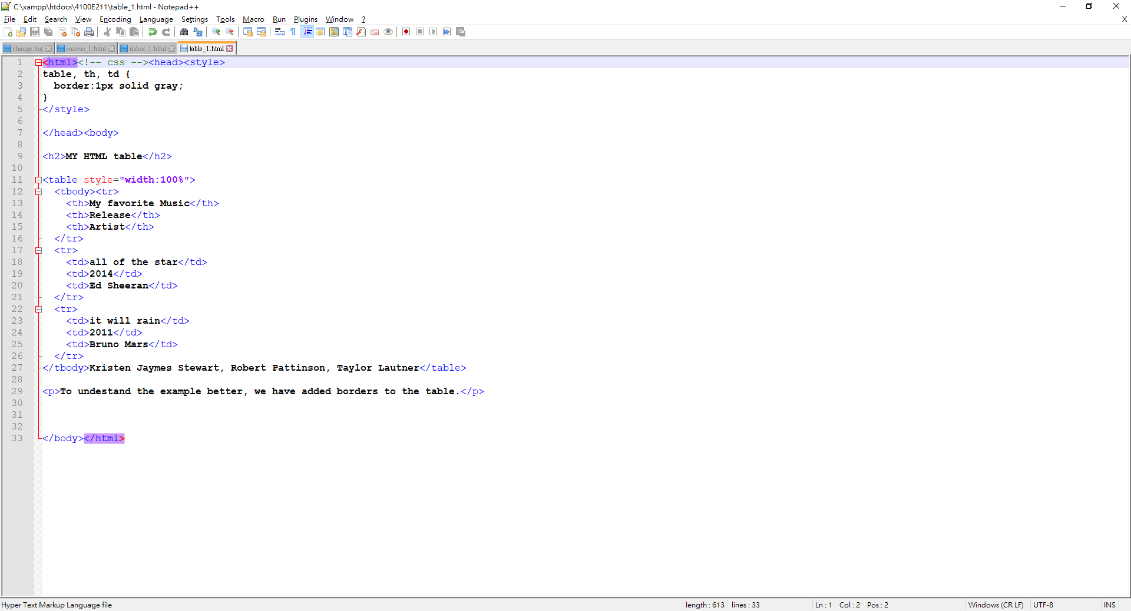
XAMPP HTML PROGRAMMING
Table_1.html

Slide 24
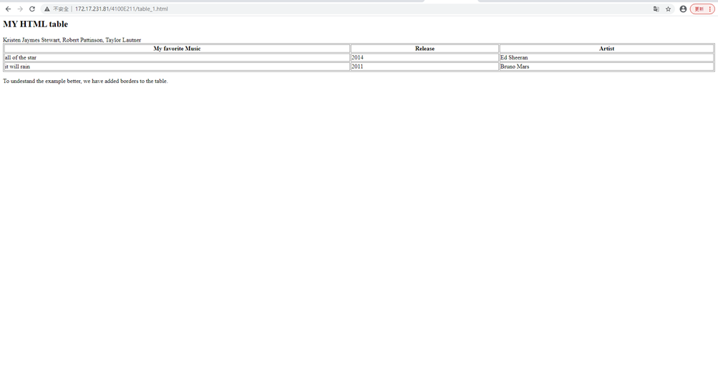
Result

Slide 25
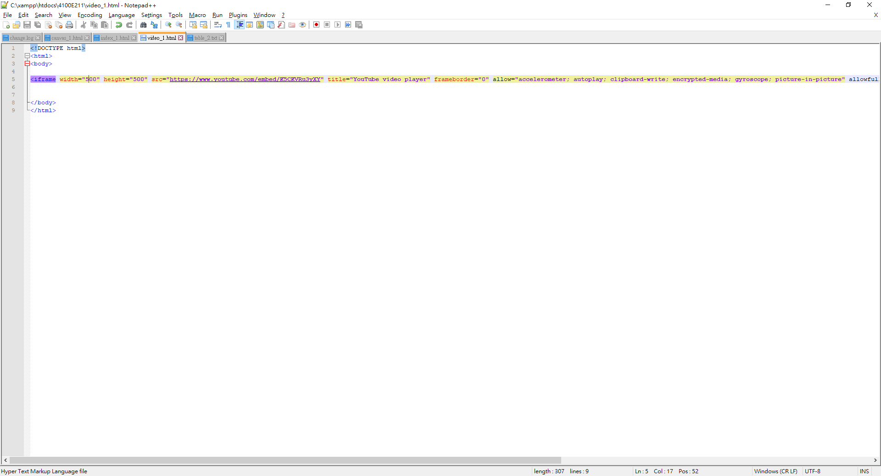
XAMPP HTML PROGRAMMING
Video_1.html

Slide 26
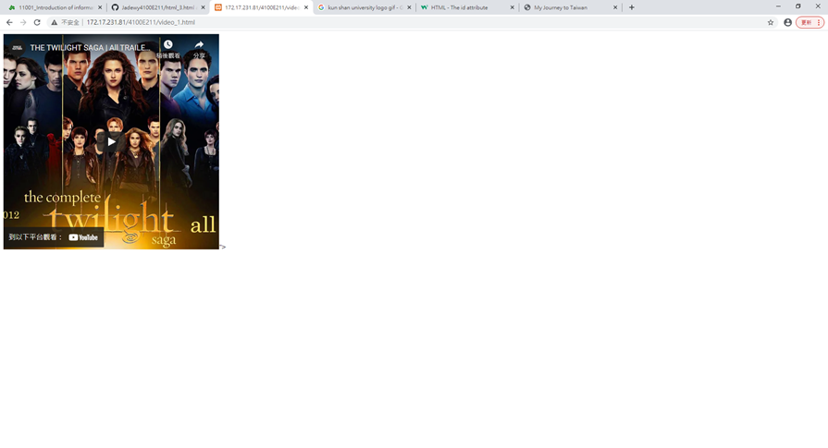
Result

Slide 27
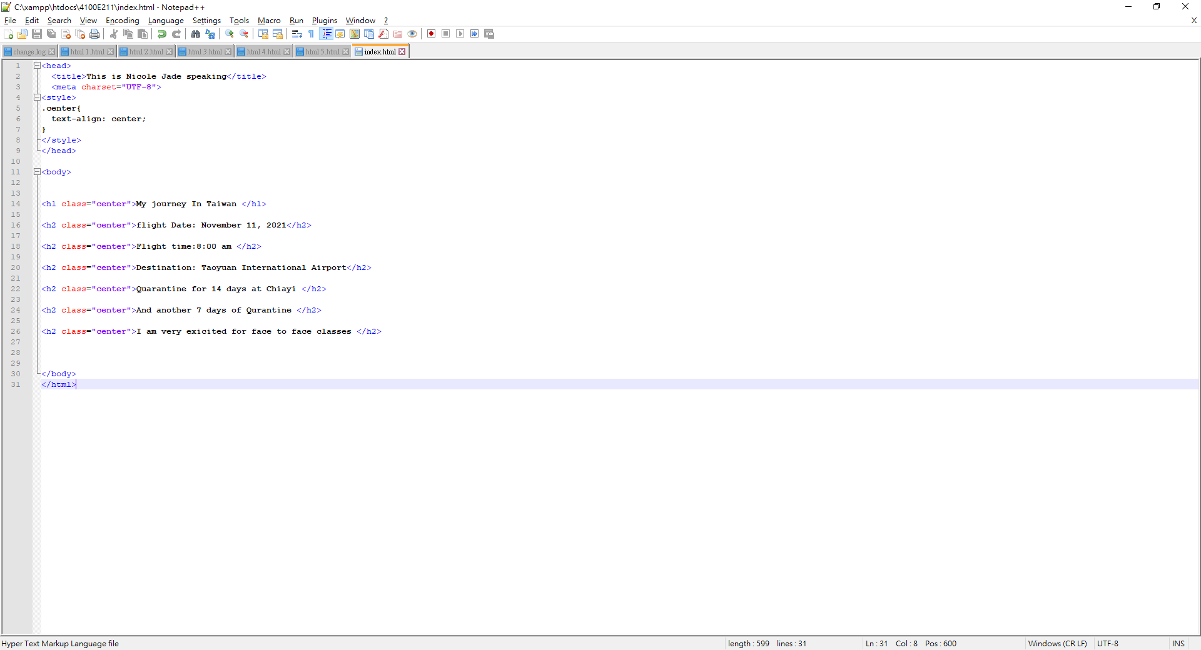
XAMPP HTML PROGRAMMING
Index.Html

Slide 28
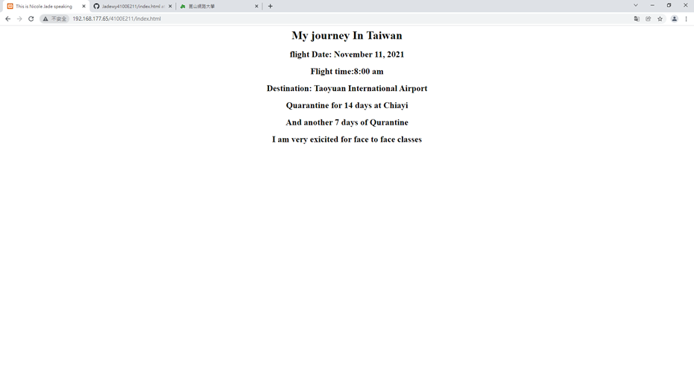
Result

Slide 29
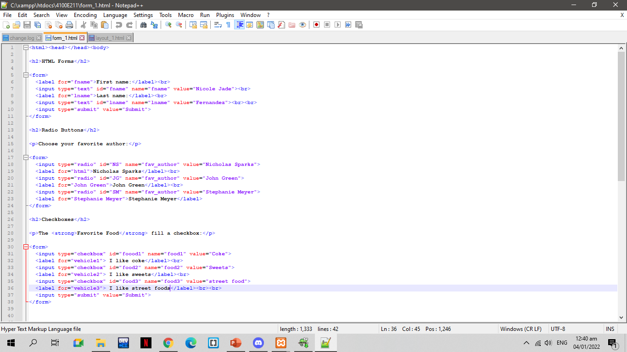
XAMPP HTML PROGRAMMING
Form 1.html

Slide 30
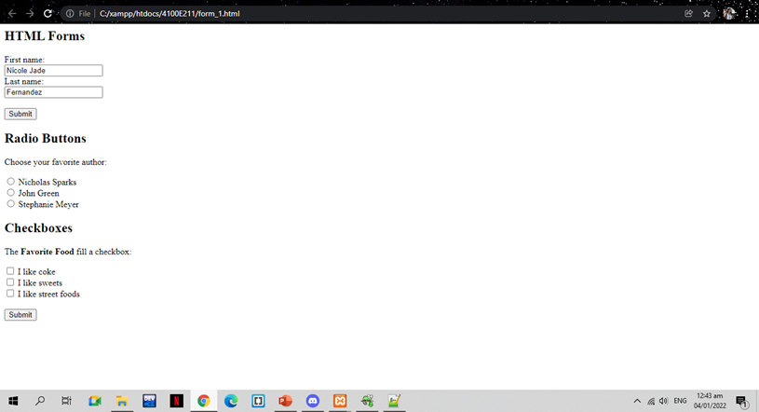
Result

Slide 31
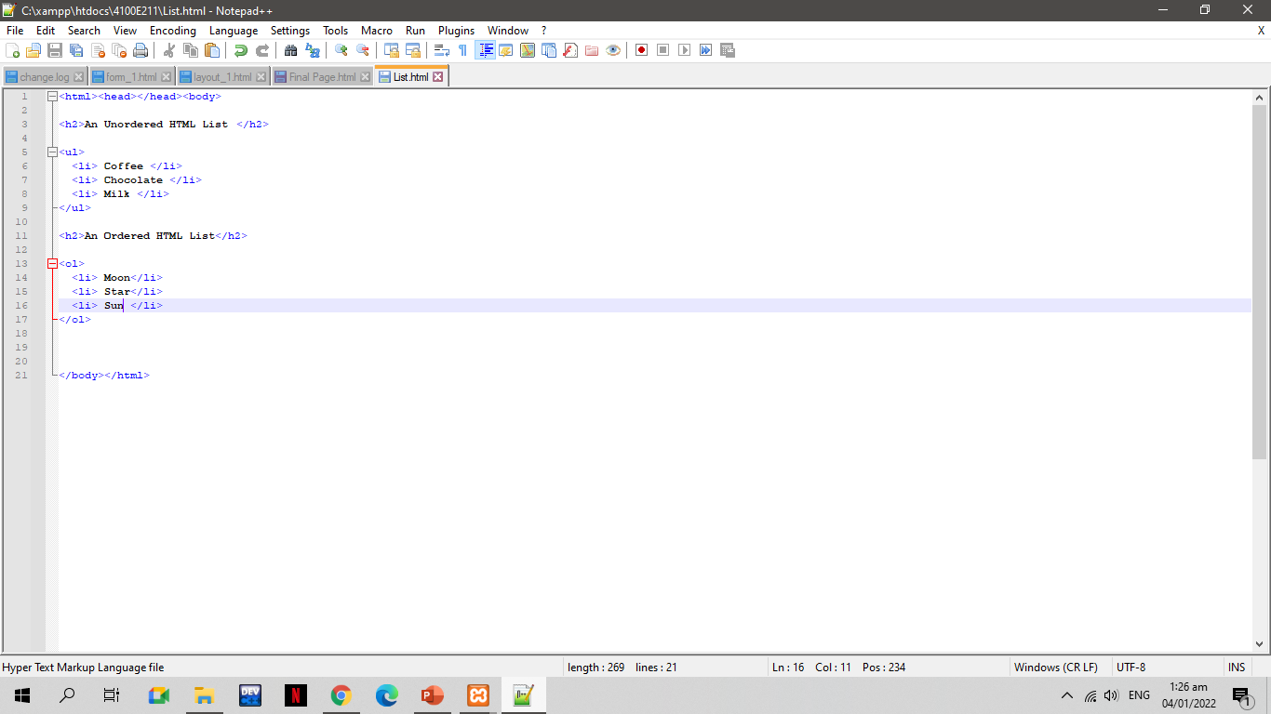
XAMPP HTML PROGRAMMING
Order List. Html

Slide 32
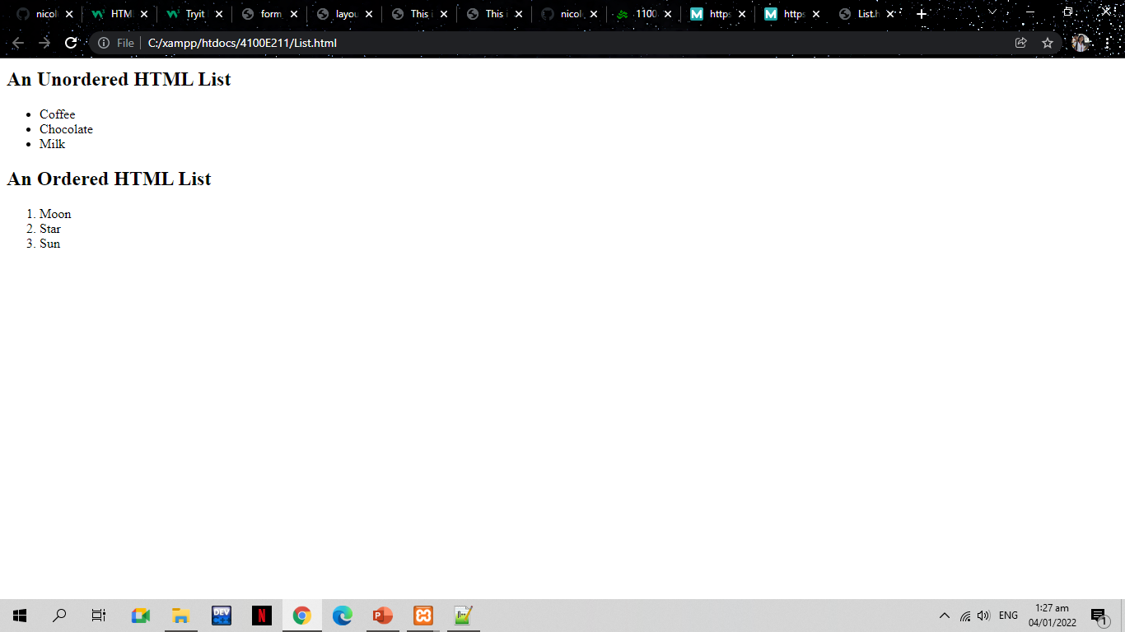
Result

Slide 33
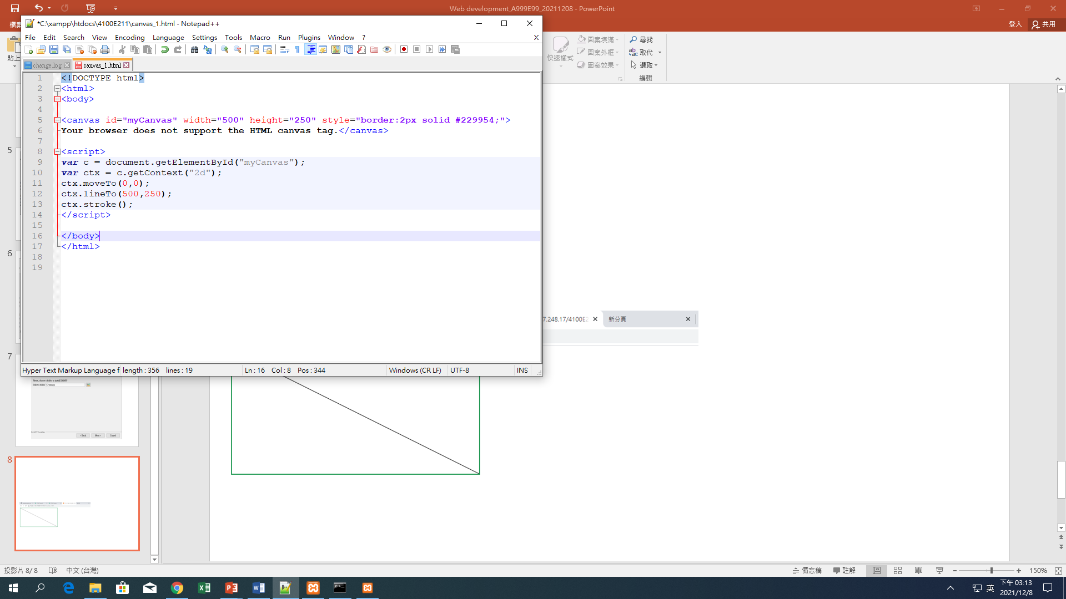
XAMPP HTML PROGRAMMING
(CANVAS - LINE)

Slide 34
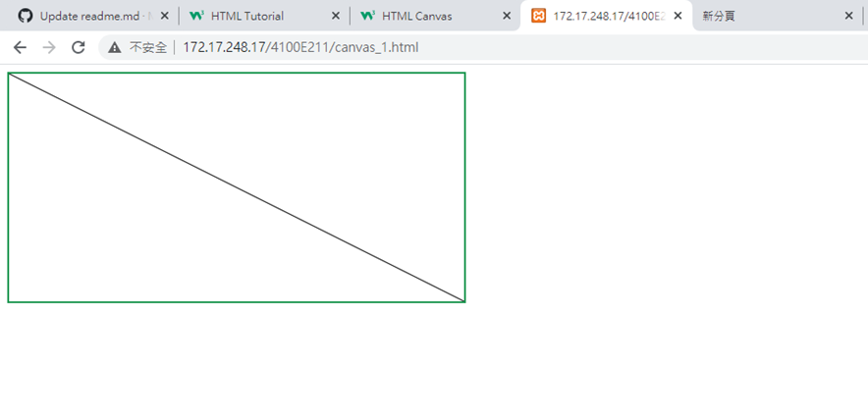
Result

Slide 35
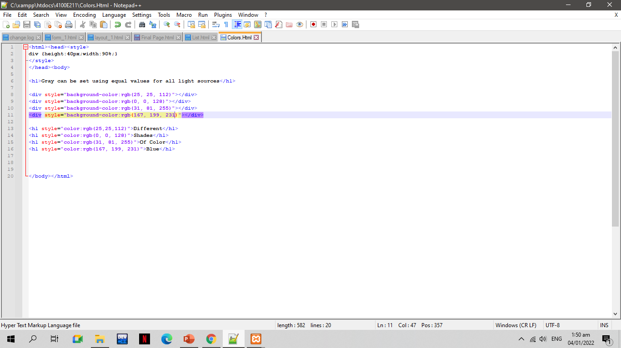
XAMPP HTML PROGRAMMING
Colors. Html

Slide 36
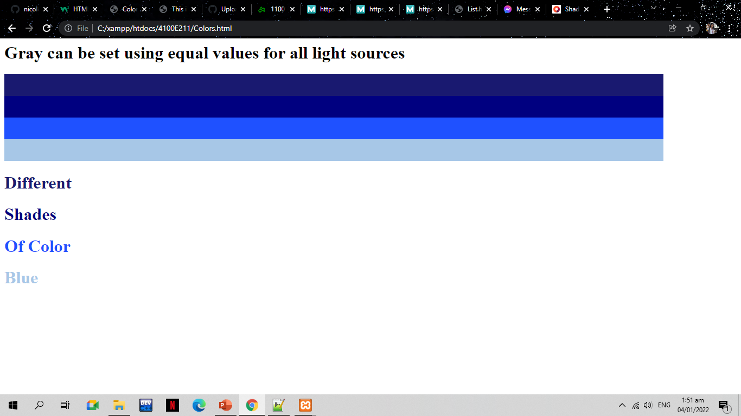
Result

Slide 37
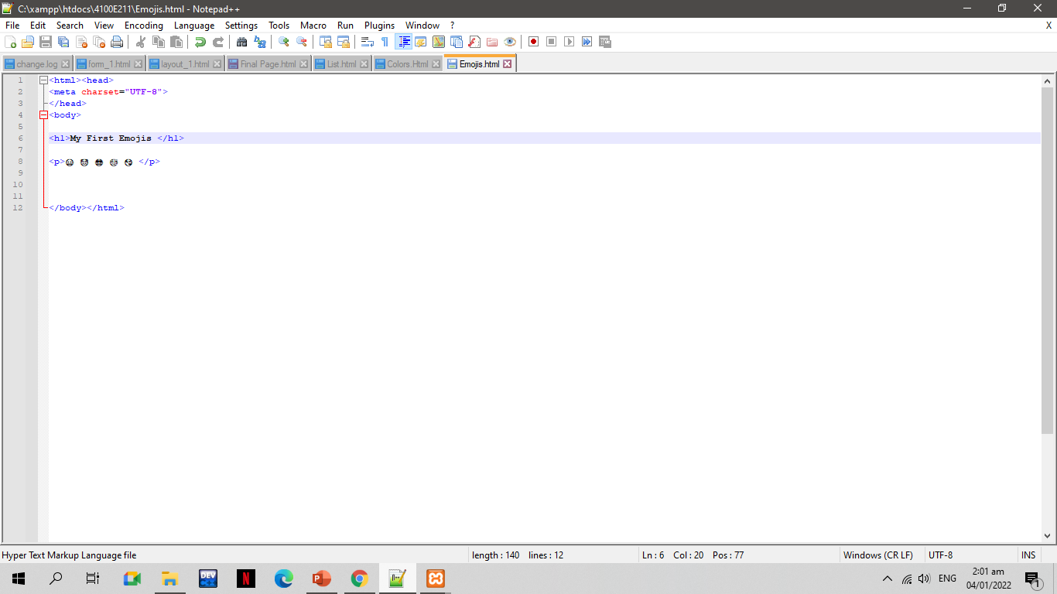
XAMPP HTML PROGRAMMING
Emojis.Html

Slide 38
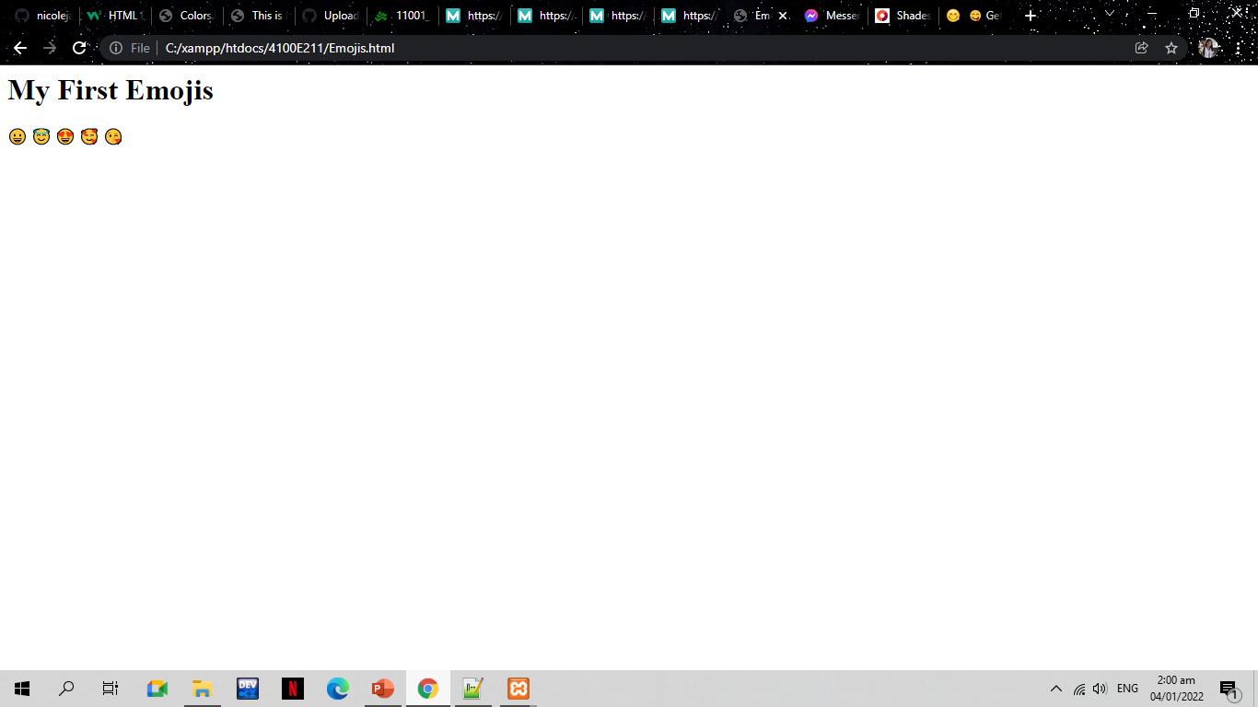
Result

Slide 39
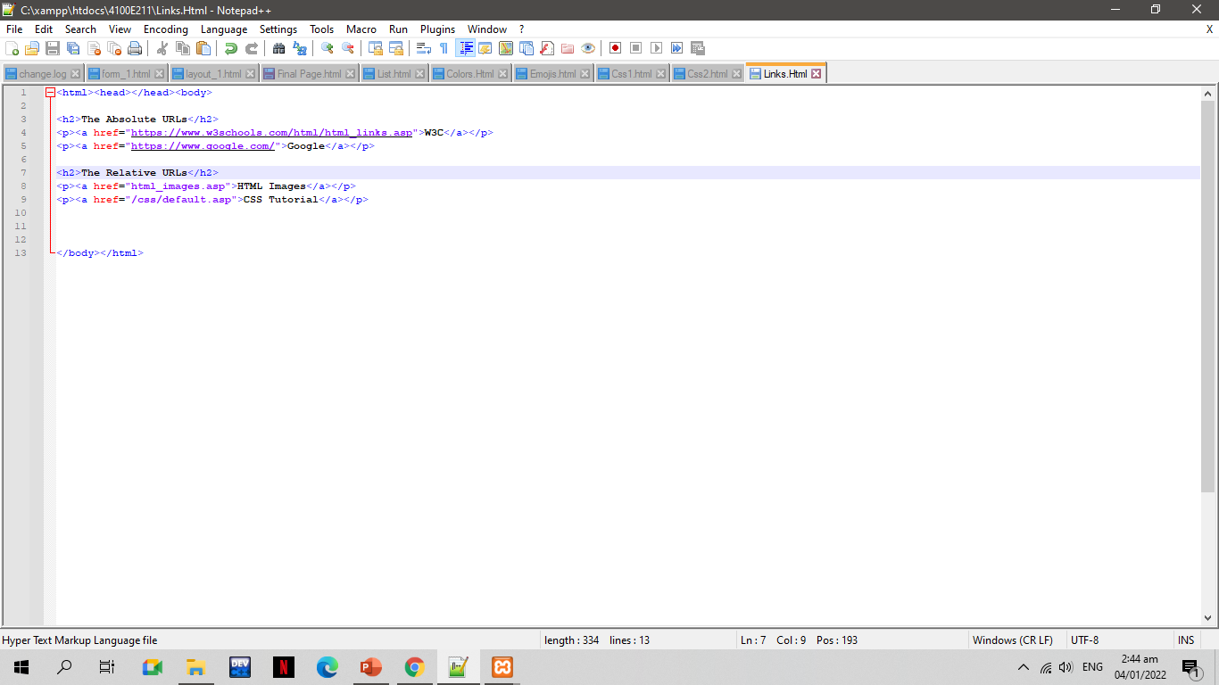
XAMPP HTML PROGRAMMING
Links.Html

Slide 40
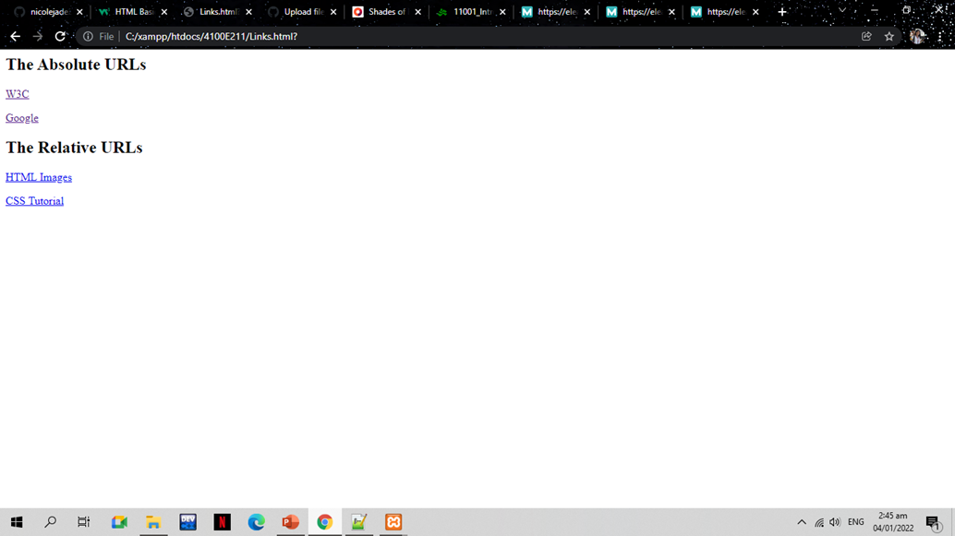

Slide 41
Cascading Programming

Slide 42
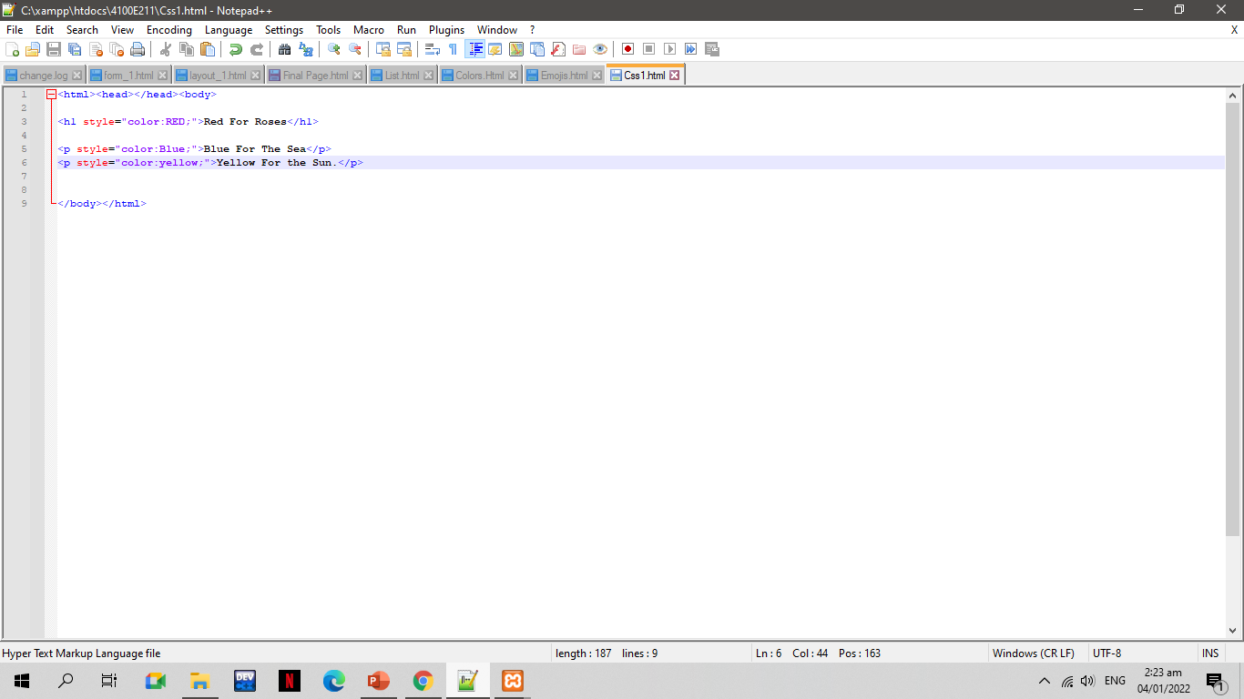
XAMPP CSS PROGRAMMING
Css1.html
Code Note++

Slide 43
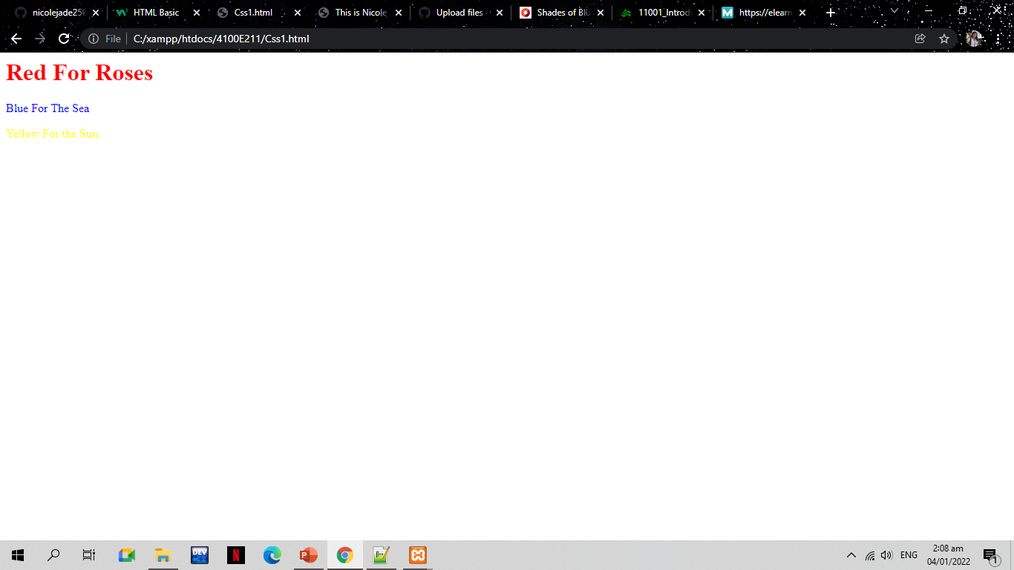
Result

Slide 44
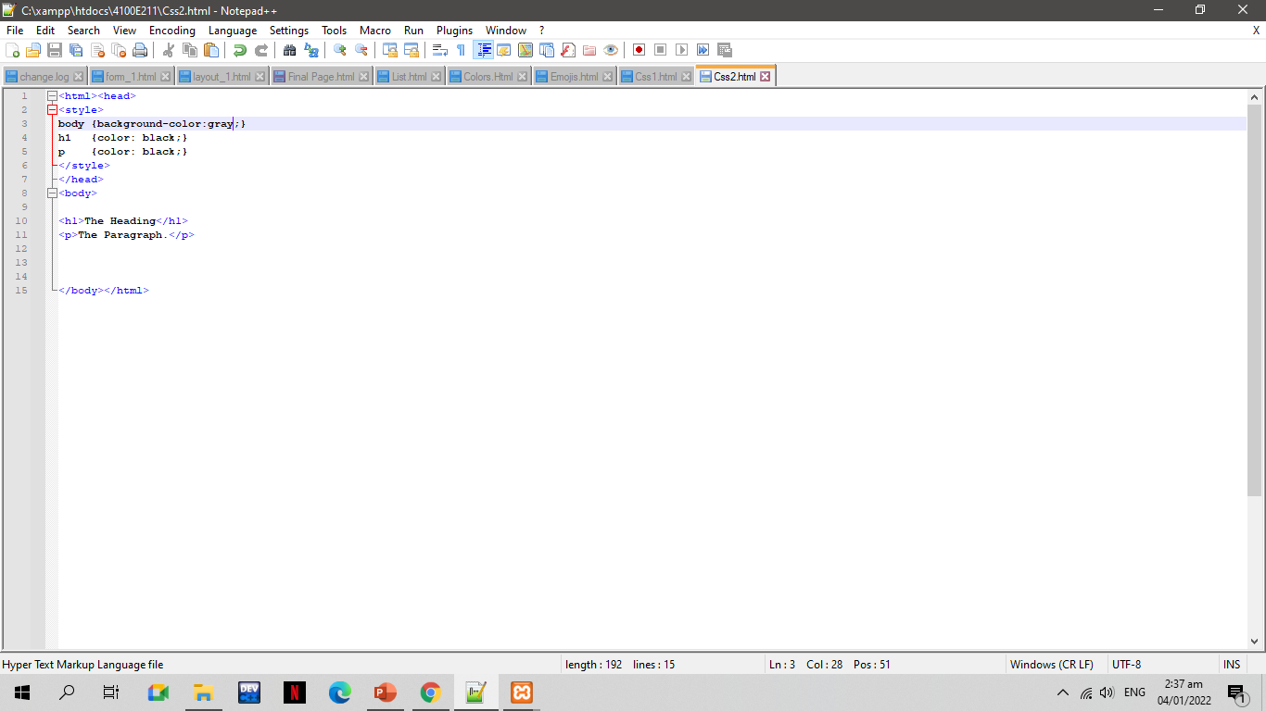
XAMPP CSS PROGRAMMING
CSS2.HTML
Code Notepad++

Slide 45
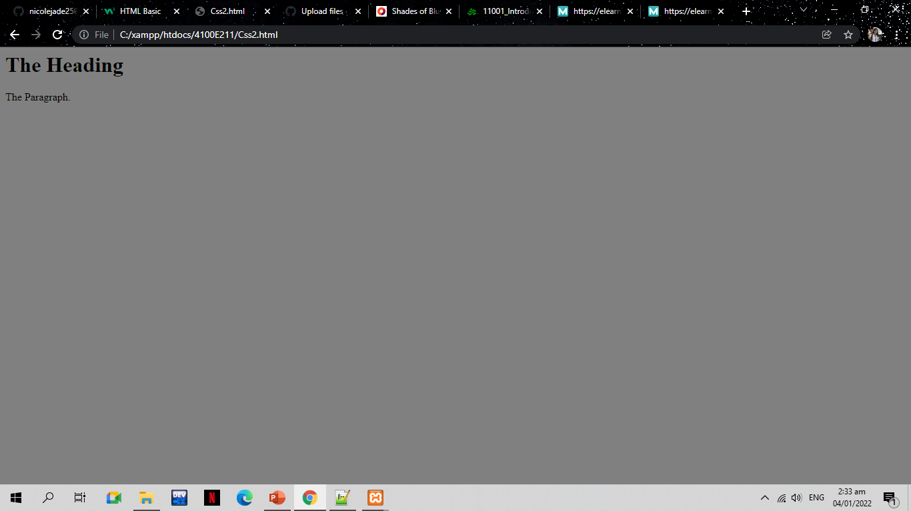
Result

Slide 46
Server-side programming

Slide 47
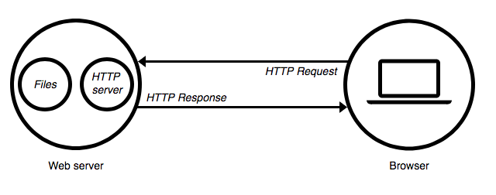
SERVER –SIDE PROGRAMMING https://medium.com/@BaaniLeen/web-development-series-intro-to-server-side-scripting-fe5626323f92
The server side programming is the name given to all types of programs which run on the web server. They process the user input, interact with the databases and control what content is served back to the client as a response to his request
Server-side processing happens when a page is first requested and when pages are posted back to the server. Examples of server-side processing are user validation, saving and retrieving data, and navigating to other pages.
It is written in a number of programming languages including PHP, NodeJS, Python, etc and has full access to the server’s OS and the programmer can chose the language he/she wants to code in.
Server-side programming is extremely useful as it helps to efficiently deliver user-customised content, and thus enhance the user experience. It can also be used to refine responses based on the user’s data (Data Analysis).

Slide 48
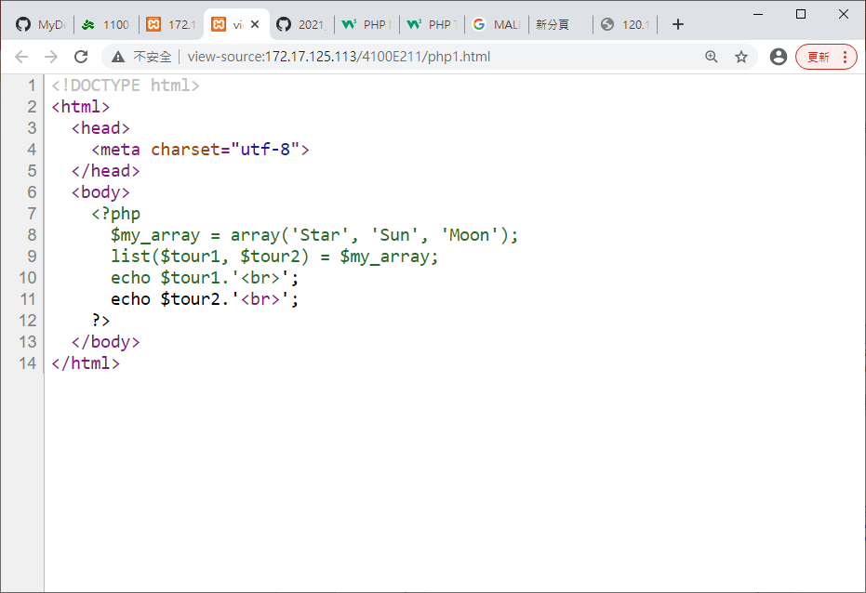
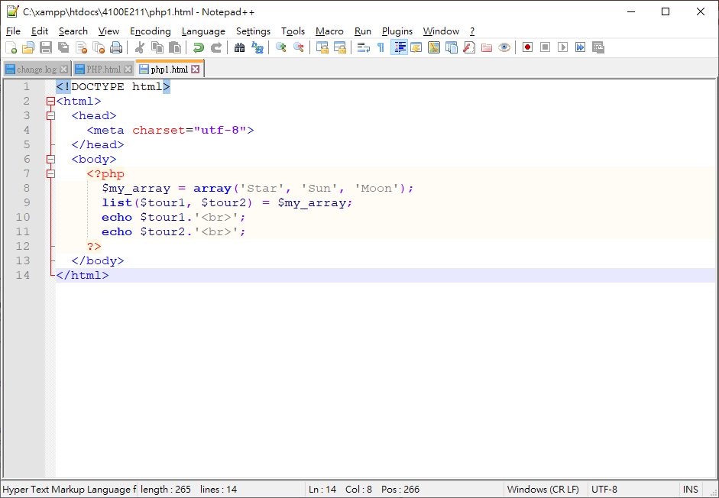
BROWSER
WHAT YOU SEE
ORIGINAL PHP PROGRAM
SERVER - SIDE PROGRAMMING

Slide 49
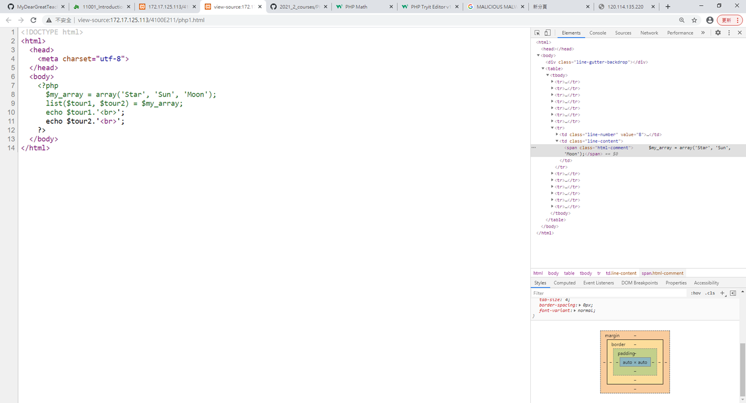
PHP1.PHP

Slide 50
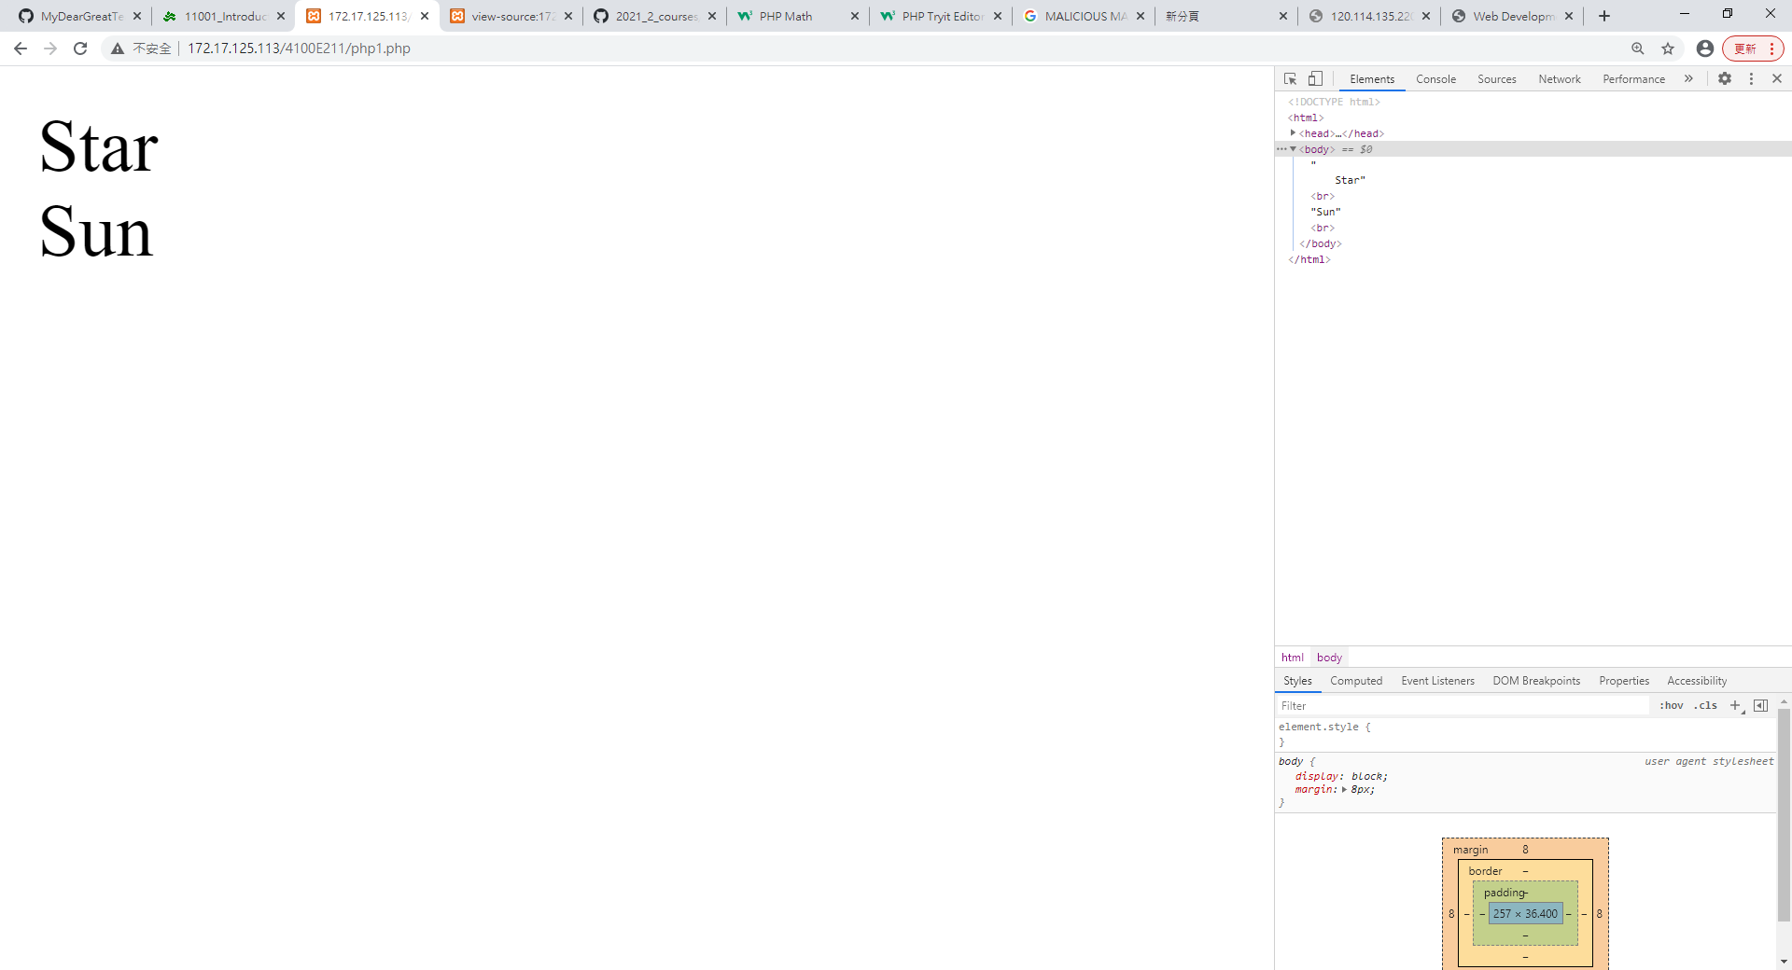
Result

Slide 51
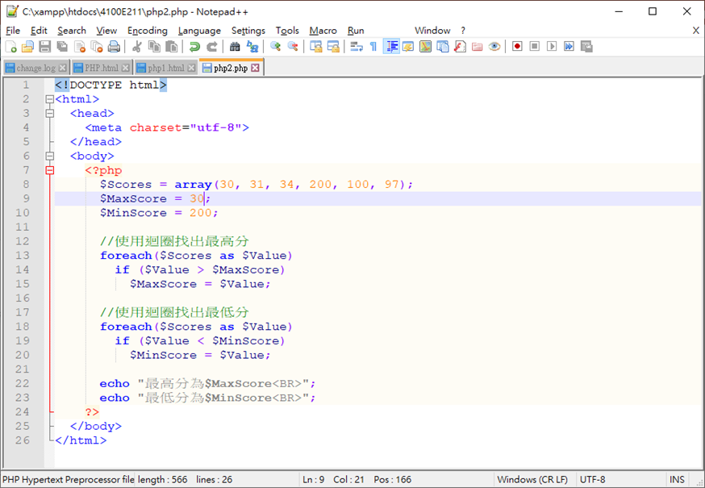
PHP2.PHP

Slide 52
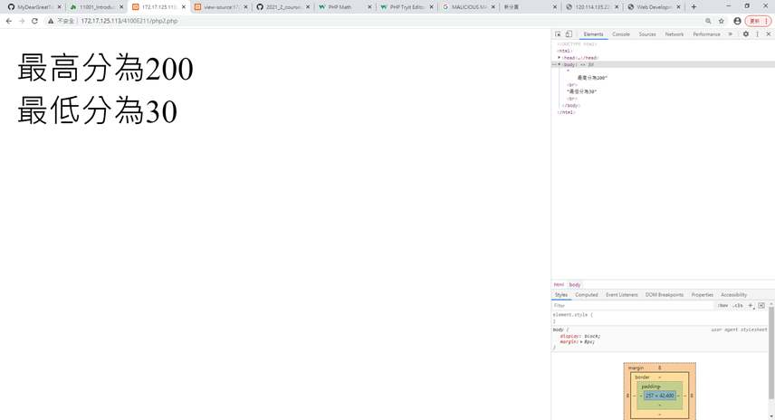
Result

Slide 53
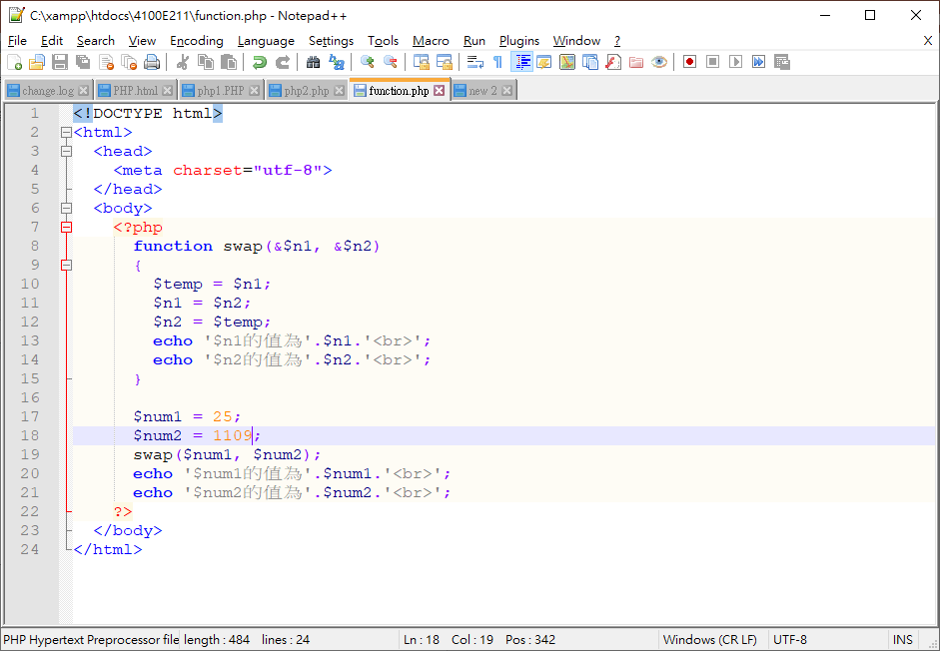
Function.php

Slide 54
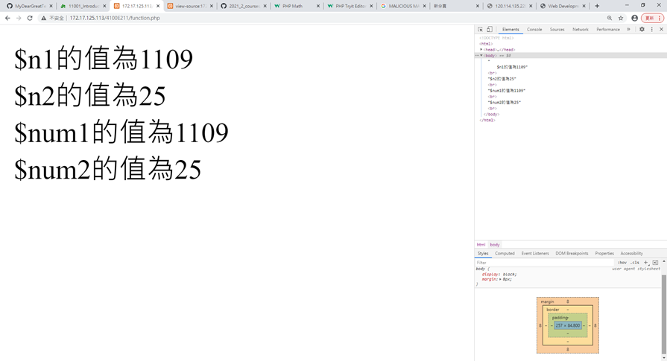
Result

Slide 55
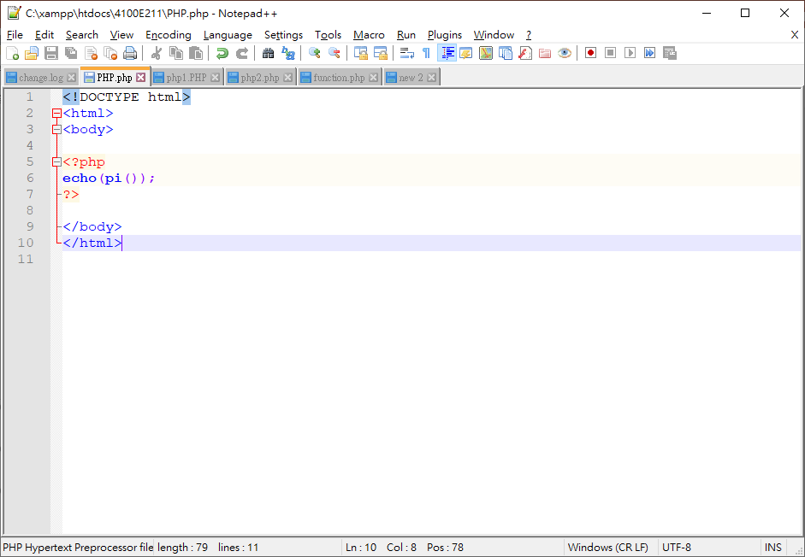
PHP.php

Slide 56
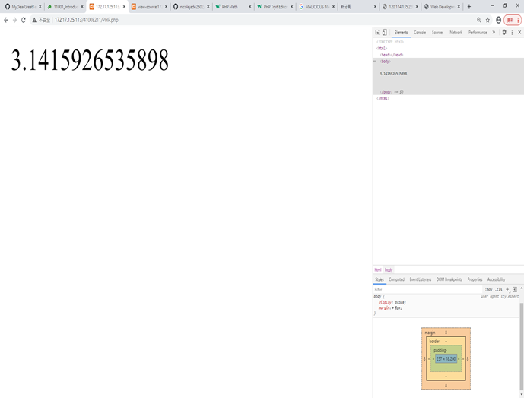
Result

Slide 57
Java Script

Slide 58
My Funny Website

